Slide 1

Why declarative UI frameworks? Thomas Künneth

Slide 2
Questions 🤔

Slide 3

Many UI frameworks are object oriented (based on component hierarchies)
In the code, each UI element is represented by a class
During runtime, the UI is represented through an object graph

Slide 4

To change the UI, we modify object properties
Callbacks / listeners handle interactions (behavior)
Get and maintain references to all required objects (UI elements)
https://unsplash.com/photos/E75ZuAIpCzo

Slide 5
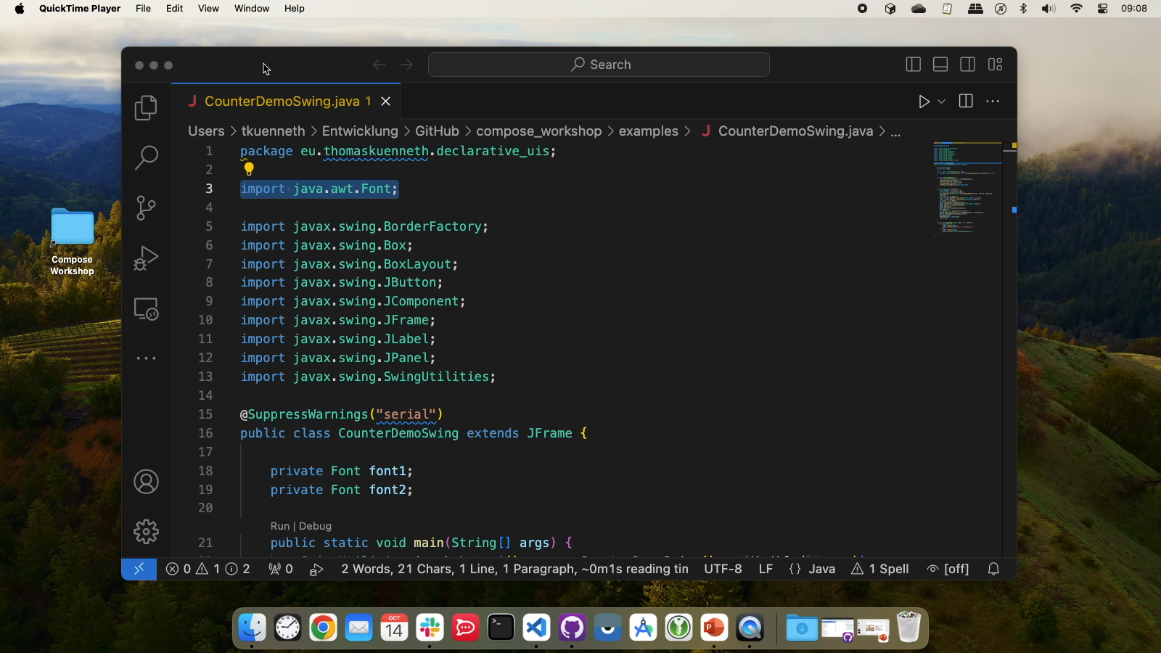

Slide 6
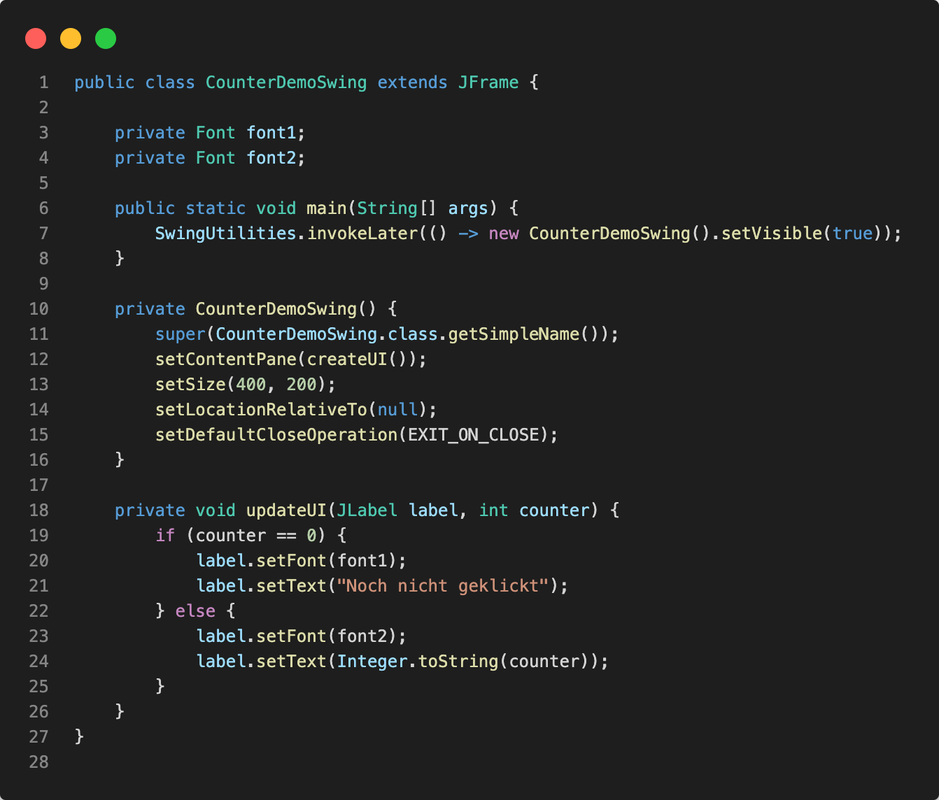
Provide an app frame
Build a component tree
Update UI based on data

Slide 7
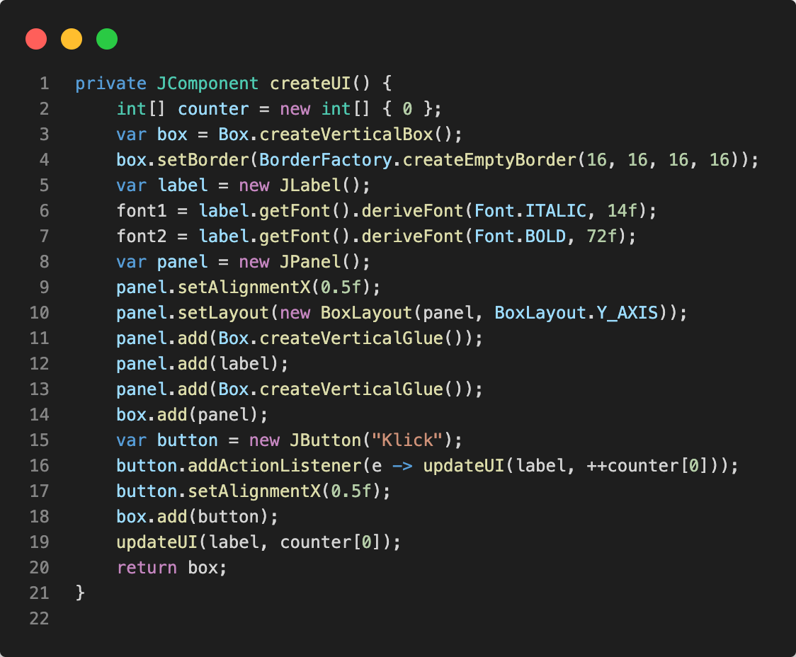
Define state
Create and configure components
Modify state and update UI

Slide 8

Tight coupling between data and logic
Creating the UI bloats the source code
Even for small UIs the code is not too easy to understand

Slide 9
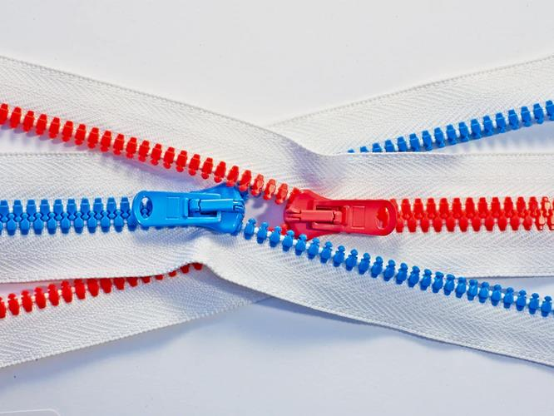
Separation of UI definition and code
Makes the source code lighter
UIs are easier to design, maintain, and share
https://unsplash.com/photos/nVqNmnAWz3A

Slide 10
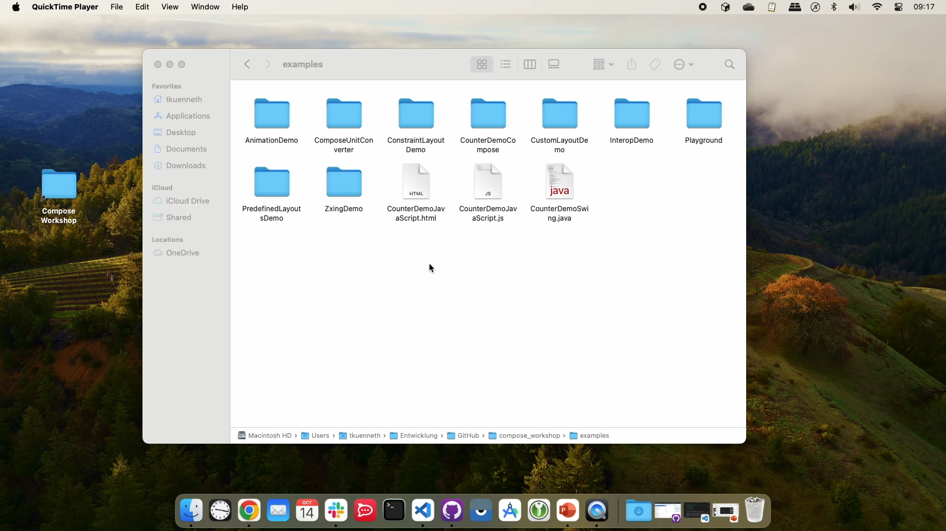

Slide 11
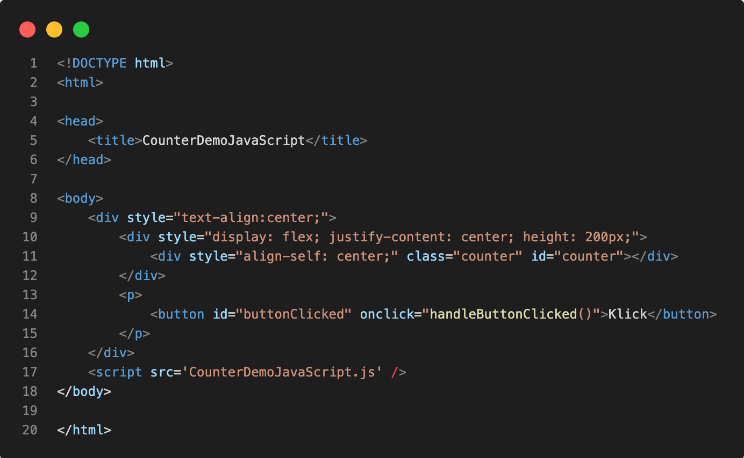
Declare a tree of components
Define parts of visual appearance
Connect UI elements to code

Slide 12
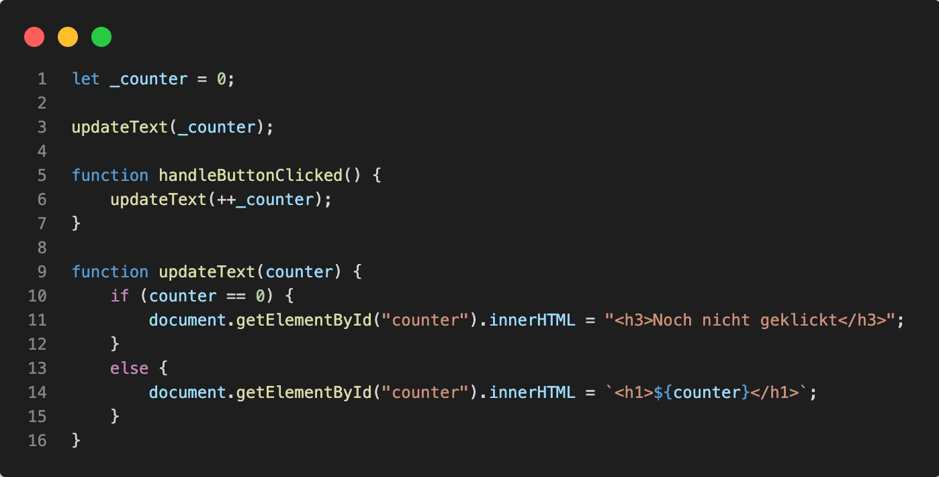
Define state
Modify state
Update UI based on state
Connect code to the UI tree

Slide 13

Looks elegant
Was adopted by many UI frameworks
JavaFX (FXML)
macOS / iOS (Storyboard)
WPF, Xamarin (XAML)
Android (XML)
https://unsplash.com/photos/4hbJ-eymZ1o

Slide 14
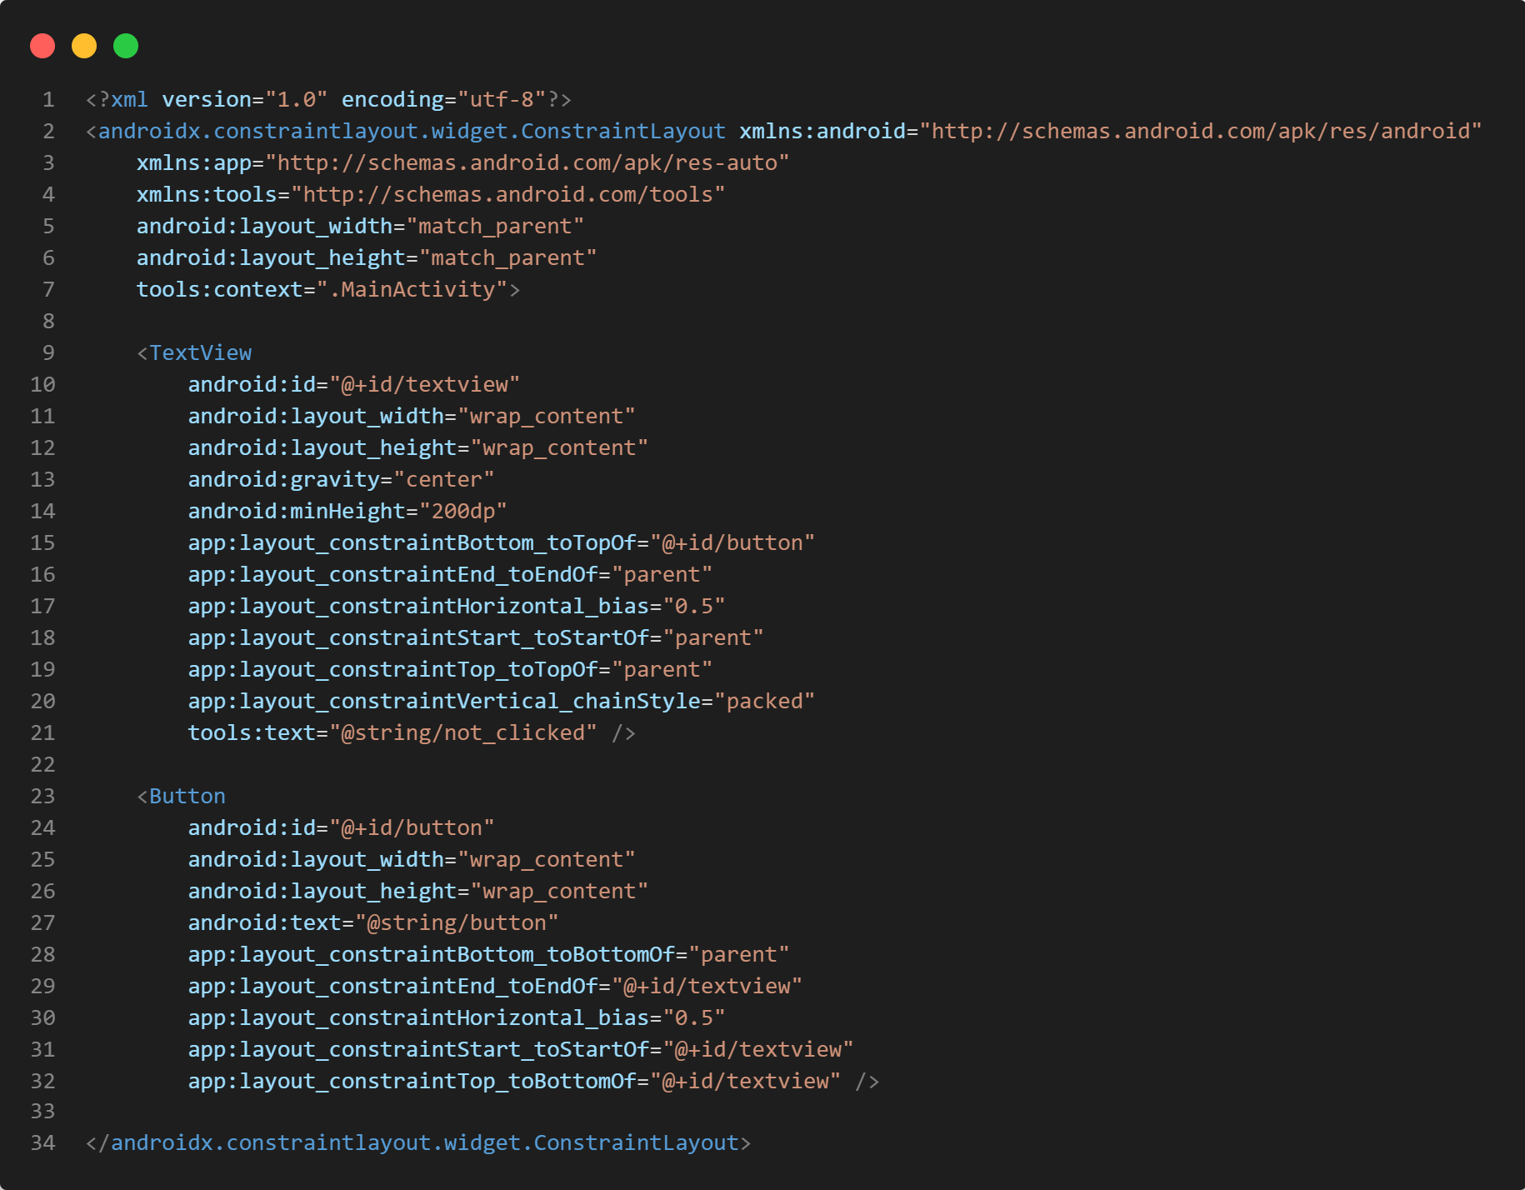
Define a tree of components
Define parts of visual appearance
Connect UI elements to code

Slide 15
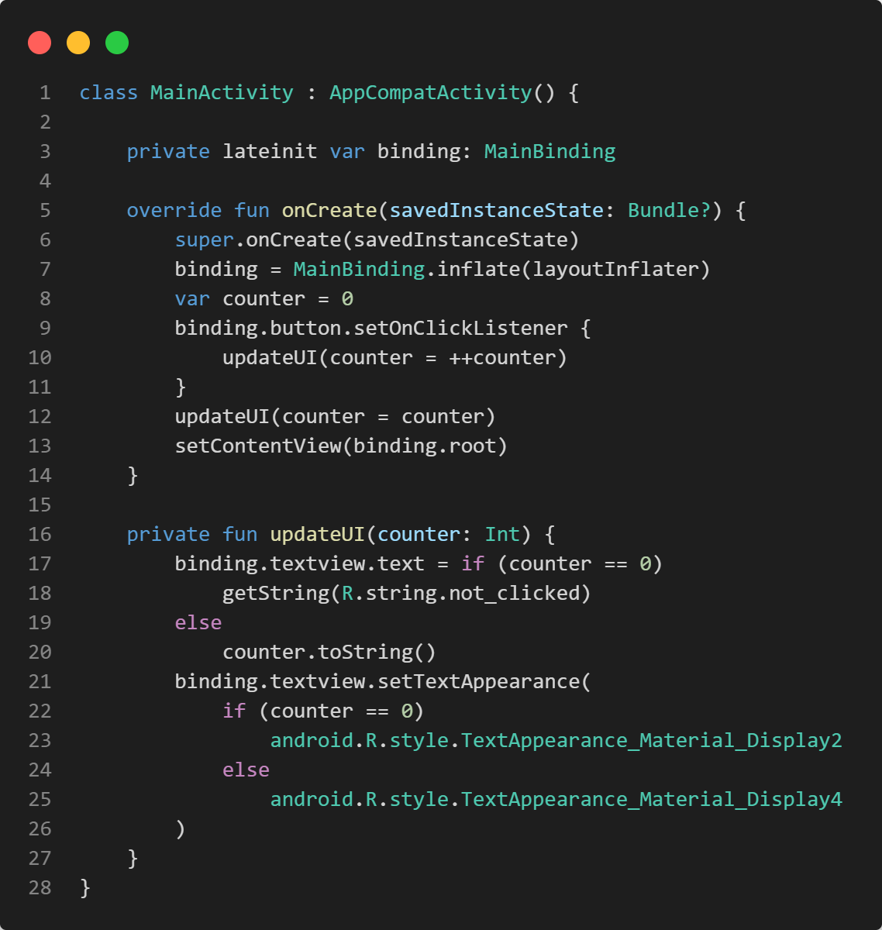
Create an activity
Build a component tree
Update UI based on data

Slide 16

Separating UI definition and behavior did not solve all problems
To make code more robust, maintainable, and easy to understand, additional measures were needed
Design patterns: MVP, MVVM, MVC, …

Slide 17

https://unsplash.com/photos/i--IN3cvEjg

Slide 18
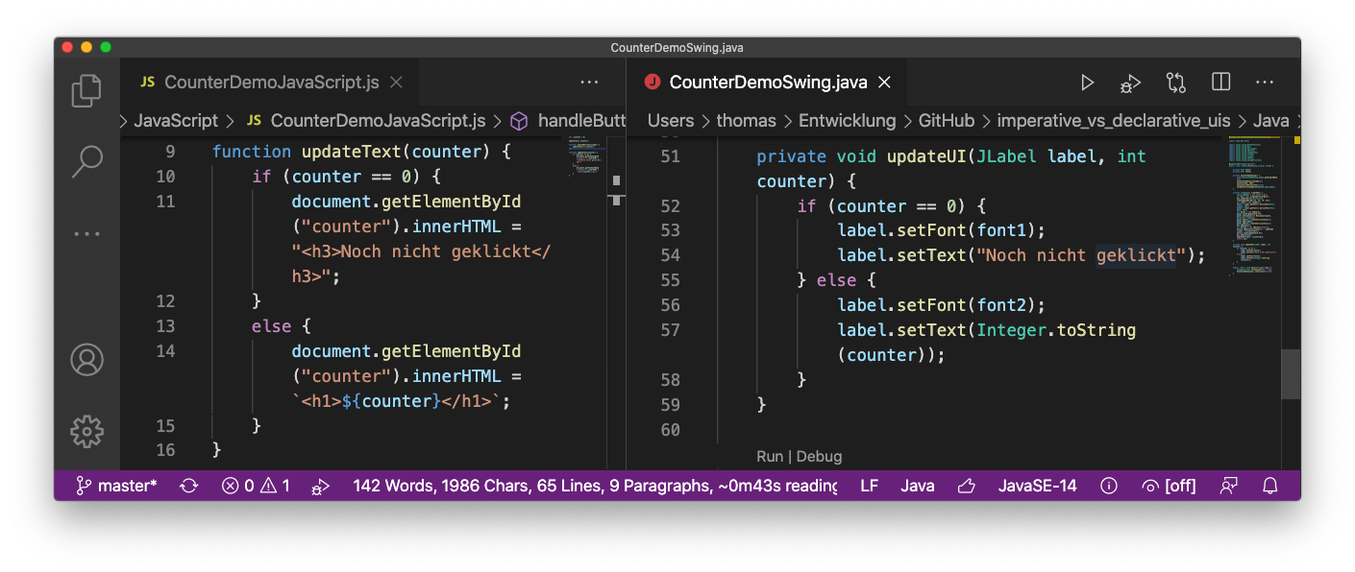

Slide 19
Changes to the UI are still done through changes to the object graph / data structures
Developer must know who the way from is to will be …
… and implement it
The bigger the change, the more difficult this may be

Slide 20

Changing the UI necessary when data shown to the user changes
Upon navigation
System events (window size changes)
https://unsplash.com/photos/slbOcNlWNHA

Slide 21


manually
Data and component tree live on their own
Important to keep both in sync
https://unsplash.com/photos/qjX0QBtDXto
with magic
https://unsplash.com/photos/AJ_Mou1FUS8

Slide 22


UI frameworks learned to sync app and UI data through a binding mechanism
Read-only components just need one-way bindings
Components with user interaction require two-way binding
Zip code
zip_code

Slide 23

Any change to the UI must be explicitly coded, either by changing component properties, or by modifying the tree itself
https://unsplash.com/photos/KbPVj7knbTU

Slide 24

Works well in small projects, but doesn‘t really scale
https://unsplash.com/photos/KnQ980sdlqU

Slide 25

Declarative UI frameworks
https://unsplash.com/photos/yg8pLPTAY8M

Slide 26

No longer require the developer to know the way from A to B
So, no longer…
How do I change xyz, so that it looks like…?
Which objects do I hide / add / delete to …?
https://unsplash.com/photos/fteR0e2BzKo

Slide 27
Instead:
How should the UI look now?
Which elements are visible?
And what are their features?
How to do that is the job of the framework, not the developer
Pioneer Web: React with Virtual DOM

Slide 28
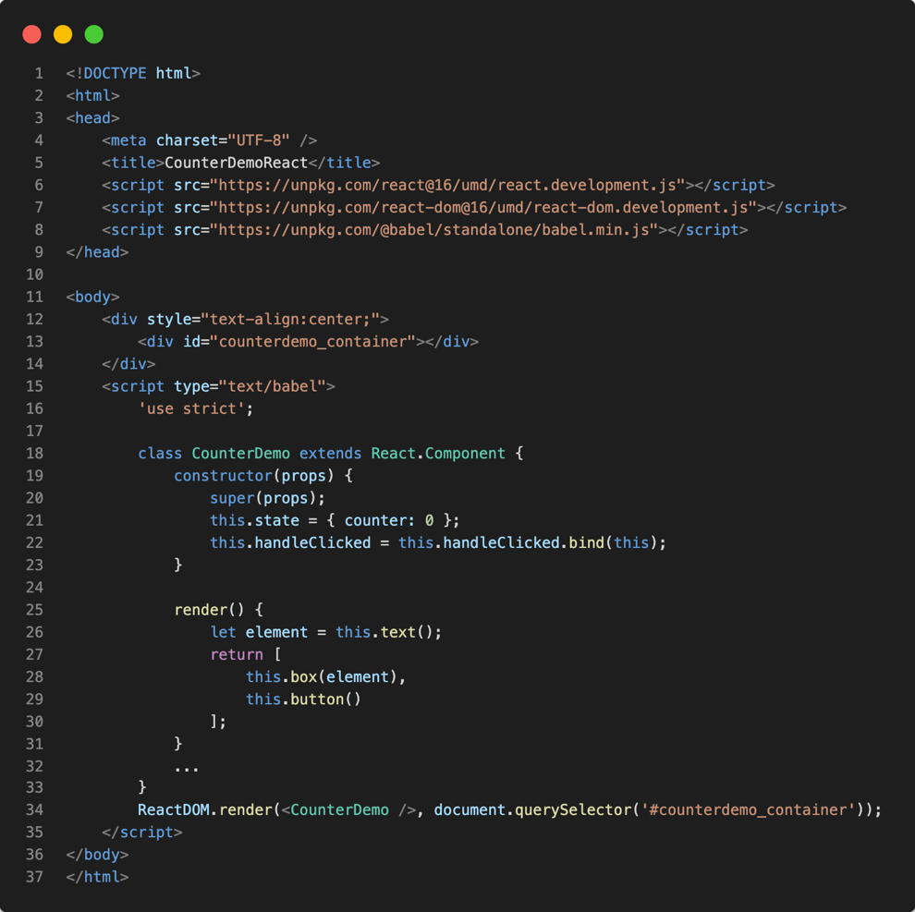
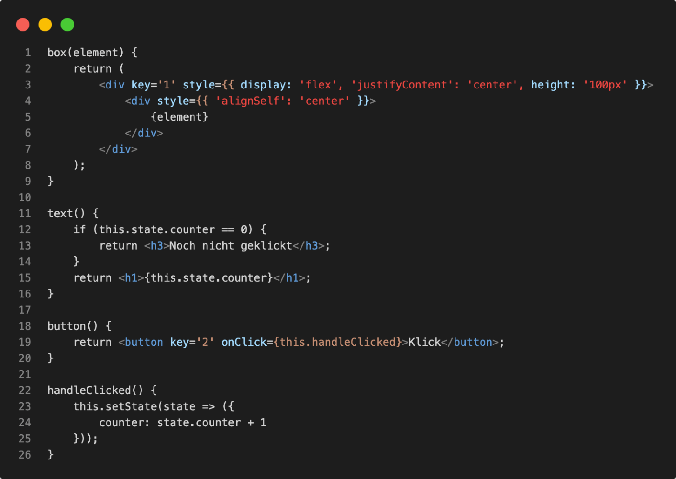
Declaration of the UI is based on state
The component is based on state
State changes are wrapped inside setState()
Tell React to render a component

Slide 29

Flutter (2015)
SwiftUI (2019)
Jetpack Compose (2019)

Slide 30

User interface is declared based on state
No need to modify (transform) the existing component tree
UI updates itself upon state changes

Slide 31

Frameworks maintain internal representation of the user interface
Must make sure that state changes trigger updates
(Should be) irrelevant for the application developer
https://unsplash.com/photos/wdxb9OOMQOs

Slide 32
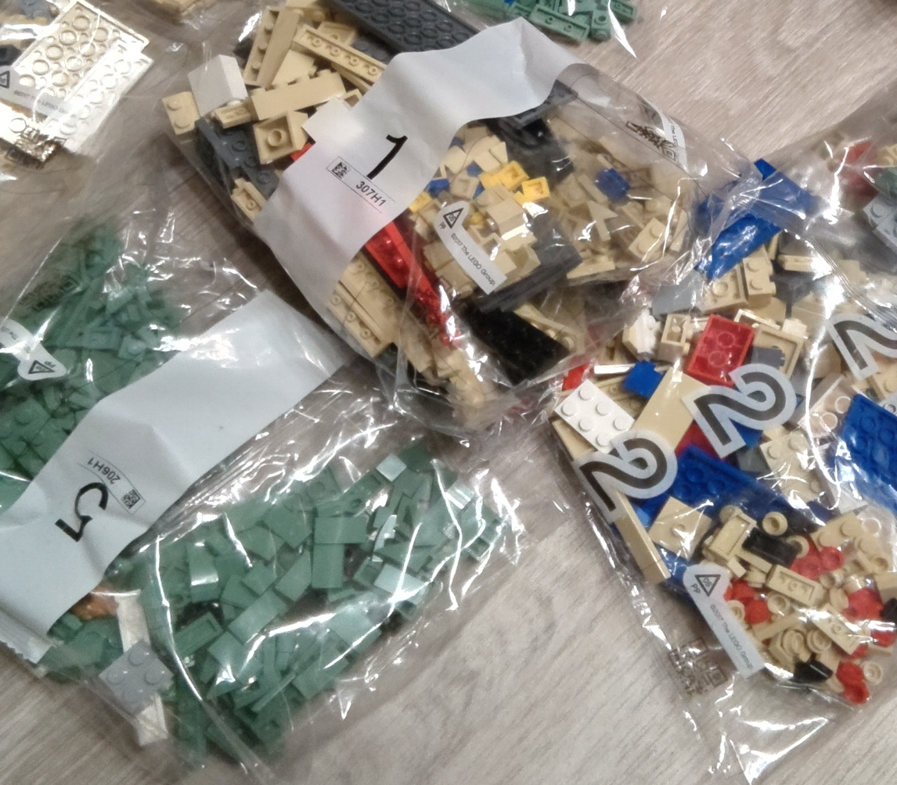
Declarative UI frameworks may rely on components and properties to define appearance and behaviour
But they favor small reusable building blocks (composition over inheritance)

Slide 33
Fast development cycles
Lean code
Preview in the IDE or „hot reload“
Static code analysis for UI
https://unsplash.com/photos/HUJDz6CJEaM

Slide 34

Paradigm shift
Prevent bugs through avoiding boilerplate code
Once adopted, high productivity
https://unsplash.com/photos/j06gLuKK0GM

Slide 35

Exercise
https://unsplash.com/photos/IZOAOjvwhaM

Slide 36
What are the most striking differences between declarative and imperative UI frameworks?
So, declarative UI frameworks don’t use components?
Can you think of potential pitfalls with the declarative approach?

Slide 37

Short break… 😍

